Slide 1

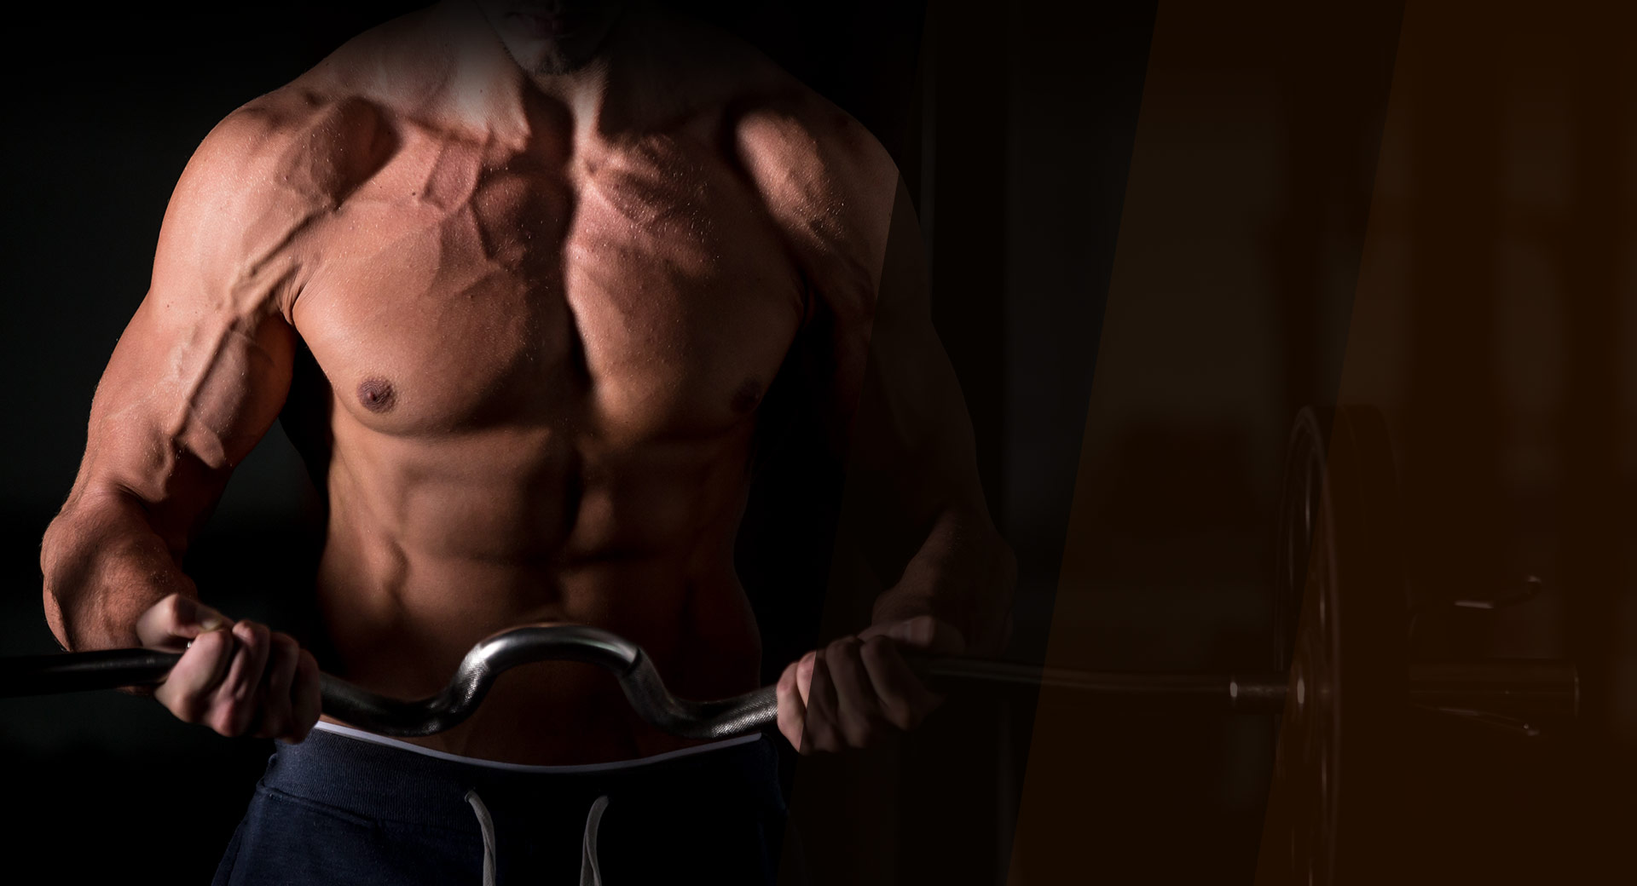
GYM WEBSITE
PROJECT BY ______________ RADHIKA VAVILALA SAIRAM BHARATH KUMAR RAVI TEJA

Slide 2
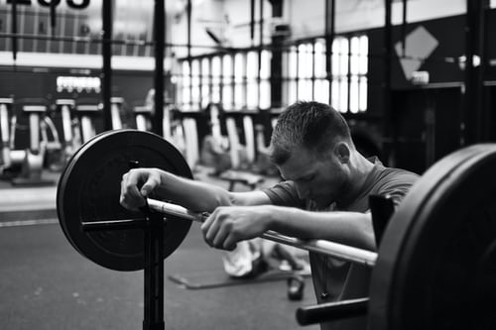
PURPOSE OF DOING GYM
REASONS :
1 : It’s plain healthy
2 : Feel better your self
3 : Great way to relieve stress
4 : Have a nice body
5 : Exercise improves mood
CONCLUSION OF DOING GYM ::
Strength training exercises for all major muscle groups at least two times a week. Examples include lifting free weights, using weight machines or doing body-weight training.

Slide 3
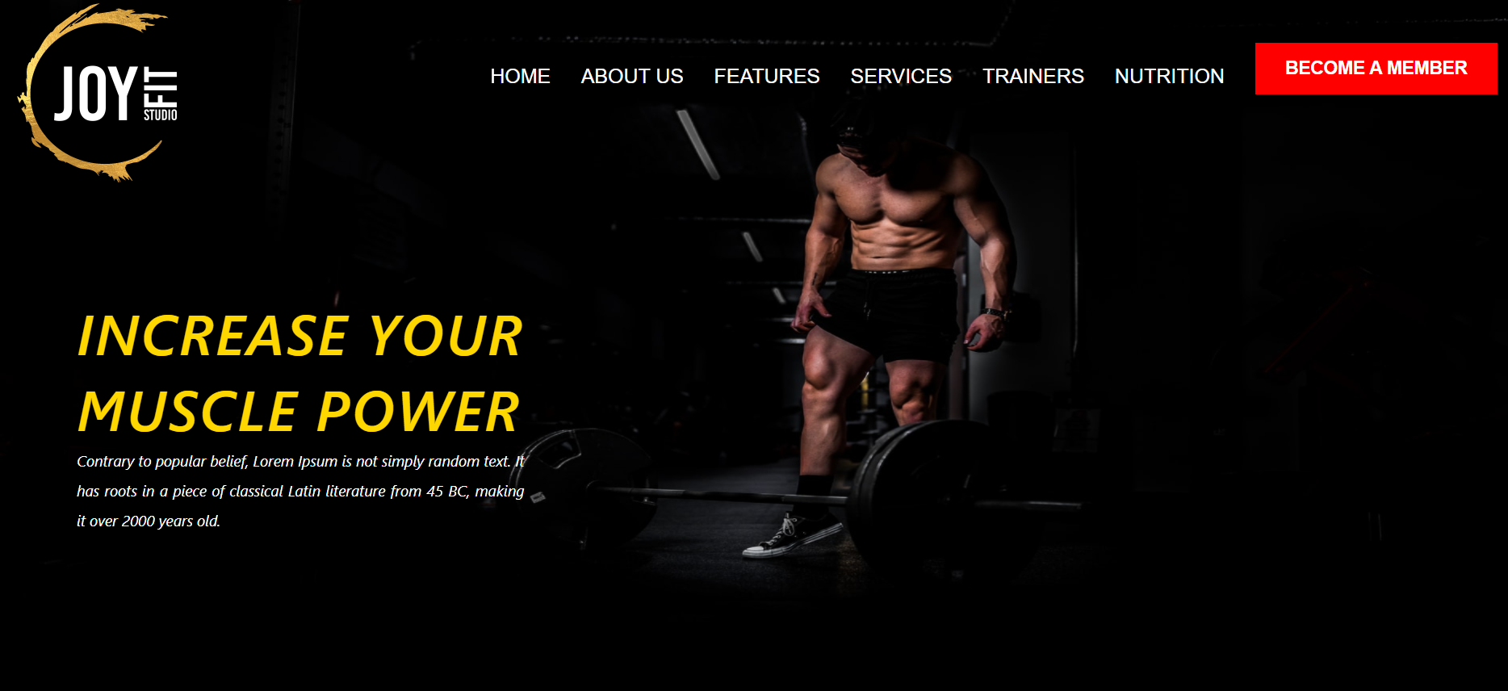
By using HTML AND CSS we developed GYM website.
In this website we used anchor tags to redirecting to different pages in HOME page which is included in website.
Pages are : Home
: About us
: Features
: Services
: Trainers
: Nutrition
: Become a member

Slide 4
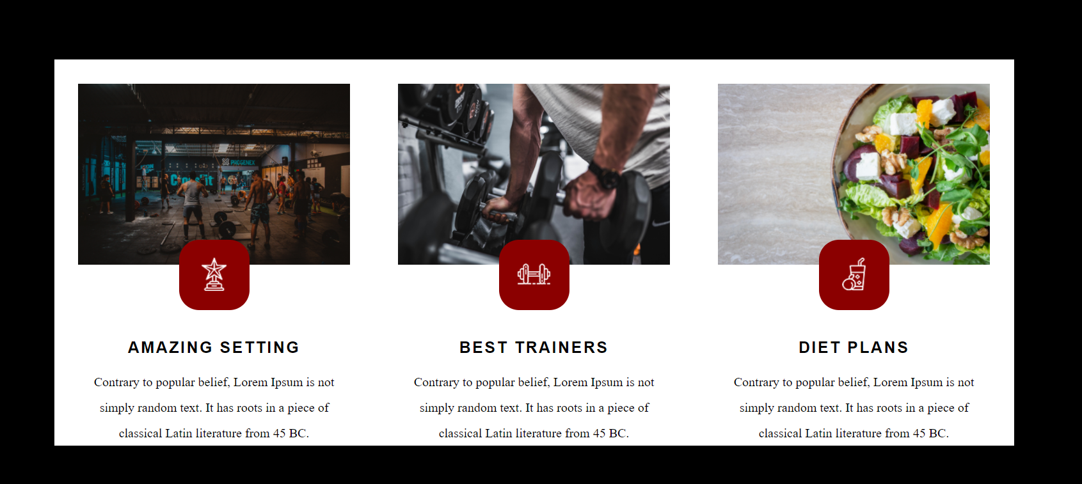
FEATURES

Slide 5
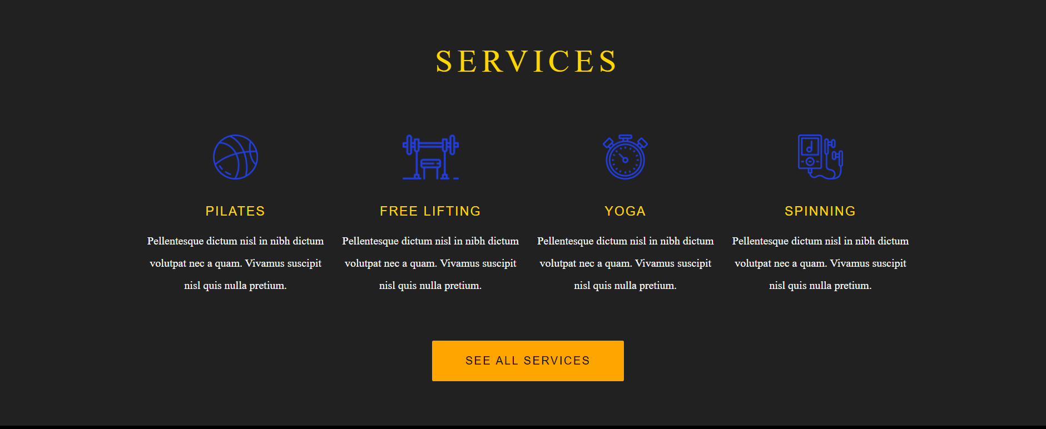
SERVICES

Slide 6
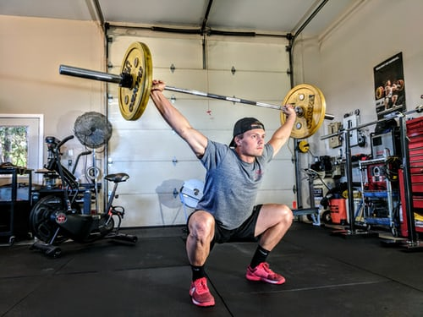
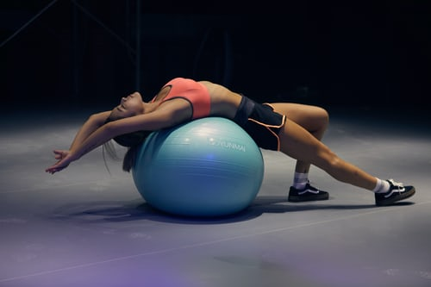
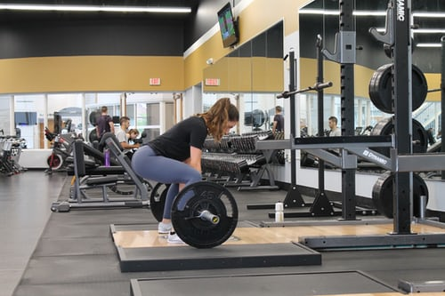
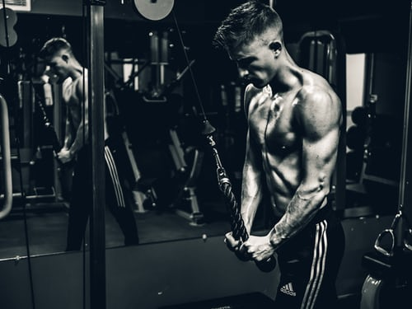
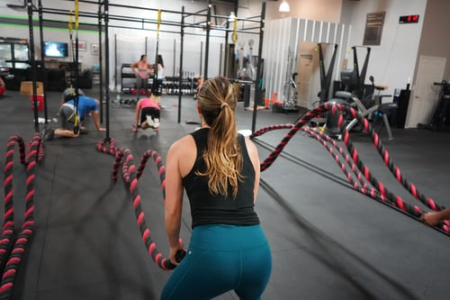
WORKOUTS IN GYM

Slide 7
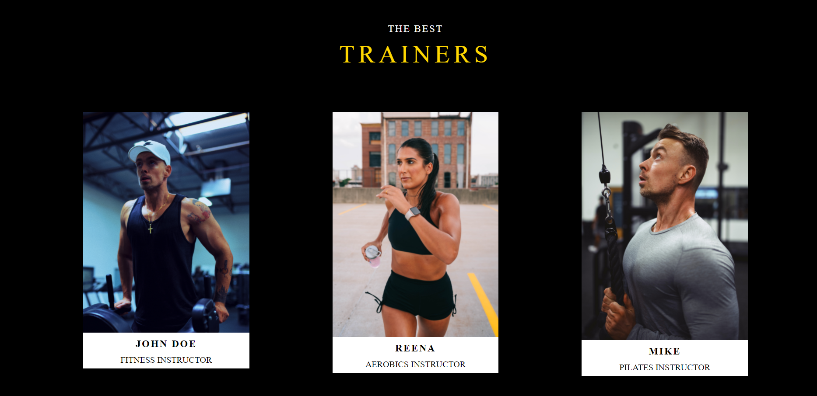
TRAINERS

Slide 8
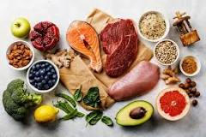
BEST DIET FOR WORKOUTS
Minimally processed foods are the best for sports and weight lifting nutrition. Lean protein, complex carbs and fiber are your best friends, especially if you’re trying to lose weight. Your body needs lean protein such as turkey, nonfat Greek yogurt, fish and egg whites to build muscle and stay full. Complex carbs, such as green leafy vegetables, give you energy to burn and fiber fills you up and keeps your digestive system and hormones in alignment.Fats should be healthy, mono-saturated fats, such as olive oil, or from plant-based sources rich in omega-3 fatty acids. Walnuts, flaxseeds and similar oils, nuts and seeds provide healthy fats.

Slide 9
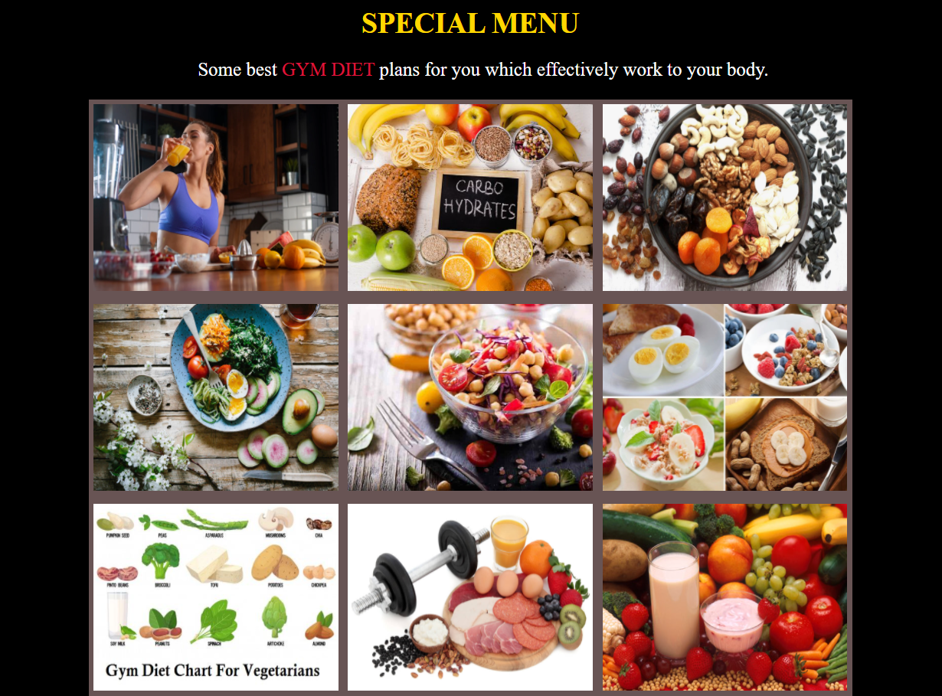
MAINTAINING DIET

Slide 10

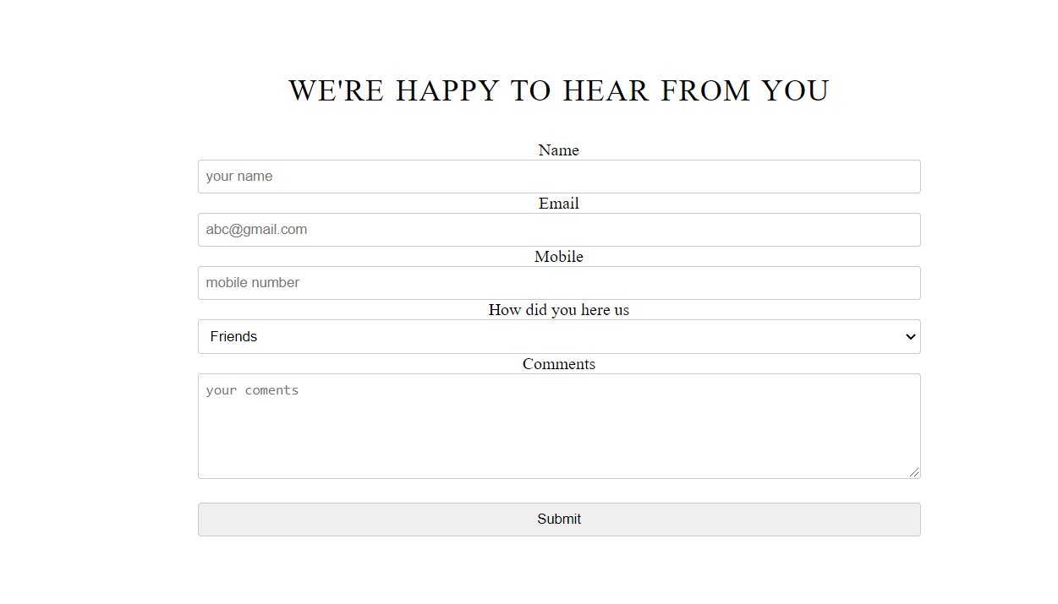
Account Sigin and Signup for Users

Slide 11
THANK YOU

